Slide 1


Whatever your challenges, we’ll be there for you.
Because when you’ve got Unum…
CE-137398
Notes:
Today we’ll talk about….

Slide 2


What’s unique about voluntary benefits?
Benefit payments made directly to YOU, the employee!
Premium conveniently payroll-deducted on a post-tax basis for a tax-free benefit
All plans are portable - if you leave the employer, you can keep these benefits!
What voluntary benefits are available?
Whole Life Insurance
Short Term Disability Insurance
Accident Insurance
Critical Illness Insurance
Who is eligible for coverage?
All eligible employees who are actively at work (Minimum 20 hours/week; 30 days)
Dependent spouses - must live in the United States
Children, stepchildren, and legally adopted children newborn to 26 years who depend on the employee for support
Unum Voluntary Benefits enrollment is here!
2
Notes:
Today we’ll talk about….

Slide 3
Did you know?
The median cost of a funeral with viewing and cremation is $6,260.¹
Benefit Highlights:
Employee volume purchase
$2,000 - $150,000 in $1,000 increments
Guaranteed issue
Issue ages 15-50: Up to $35,000
Issue ages 51-80: Up to $25,000
Spouse volume purchase
$2,000 - $35,000 in $1,000 increments
One qualifying question is always required. Up to $10,000 conditional guaranteed issue
Child volume purchase
$5,000 - $50,000 in $1,000 increments
Guaranteed issue up to $50,000 benefit amount
Living benefit included with all policies at no extra premium – allows access to death benefit when medical condition limits life expectancy to 12 months or less
Additional Feature:
Long Term Care Benefit Rider Included
Sylvia’s term life insurance provides a good base level of coverage. But if she ever loses her job, she might lose that protection. So she purchased Unum Individual Whole Life Insurance. It can help her loved ones with her final expenses, and she can keep this coverage as long as she pays the premiums, even beyond her working years.*
Plan Features:
Premiums never increase
Benefits never reduce
Policy builds cash value
Individual
Whole Life
Insurance:
Life insurance for your whole life
* For illustrative purposes only
1 National Funeral Directors Association, Statistics, 2018.
Living benefit payments will reduce the amount the policy offers upon the recipient’s death, may adversely affect the recipient’s eligibility for Medicaid or other government benefits or entitlements, and may be taxable. Recipients should consult their tax attorney or advisor before utilizing living benefit payment.
This life insurance does not specifically cover funeral goods or services and may not cover the entire cost of your funeral at the time of your death. The beneficiary of this life insurance may use the proceeds for any purpose, unless otherwise directed.
Notes:
Today we’ll talk about….

Slide 4
Leading causes of short term
disability claims in 2018:¹
Normal pregnancy
Injuries (excluding back)
Joint disorders
Cancer
Digestive disorders
Benefit Highlights:
Can replace up to 60% of an employee’s regular monthly income (40% in NJ)
Money is payable directly to employees to use however they choose
Maximum monthly benefit: $5,000
Maximum benefit period: 6 months
Pre-existing condition limitation: 12/12
Benefit does not offset with other disability benefits the employee receives
Premium waiver
Employee-paid benefit
Karen needs time to recover from having her first child. (She named him Christopher, after her father.) Her Unum Short Term Disability Insurance replaces a portion of her income, so she can pay her bills while she gets back to full strength.*
Individual Short-Term Disability Insurance:
Works when employees can’t
If NY: The Individual Short-Term Disability policy provides disability income insurance only. It does NOT provide basic medical or major medical insurance as defined by the New York State Department of Financial Services. The expected benefit ratio for the individual short-term disability policy is 60%. This ratio is the portion of future premiums which the company expects to return as benefits, when averaged over all people with this policy.
* For illustrative purposes only.
1 Unum internal data, 2018. Note: Causes are listed in ranked order.
Notes:
Today we’ll talk about….

Slide 5
Did you know?
Every 10 minutes, over 750 Americans suffer an injury severe enough to seek medical help.¹
Pays benefits for 50+ covered injuries/treatments, including:
ER visits
Broken bones
Burns
Knee ligament
Follow up visits
Dislocations
Emergency dental
Physical therapy
Wellness Benefit
Protection for employees and their families
Helps lessen the financial impact of out-of-pocket medical costs related to a covered accident that occurs off on/off the job!
Unlimited Payouts!
Employees can file claims for multiple covered incidents
Pays a lump-sum benefit based on type of injury sustained and treatment needed
Covered injuries include broken bones, cuts, burns, eye injuries, ruptured discs, coma, etc.
Benefit can be used however employees choose
Portability included!
All guaranteed issue
Premiums never increase
Group
Accident
Insurance:
Can help when
you’re hurt
1 National Safety Council, Injury Facts 2017.
Notes:
Today we’ll talk about….

Slide 6
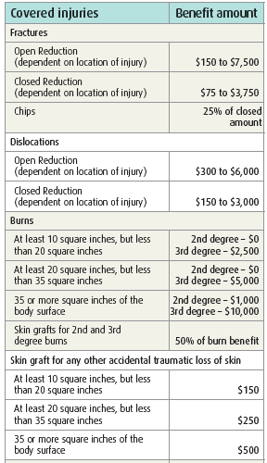

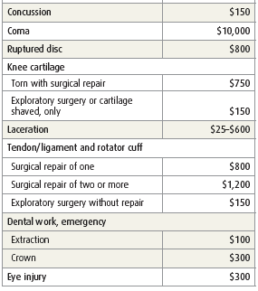
SCHEDULE OF BENEFITS
List of lump-sum benefit payment amounts based on type of injury sustained and treatment needed
Group
Accident Insurance:
How it works
Notes:
Today we’ll talk about….

Slide 7
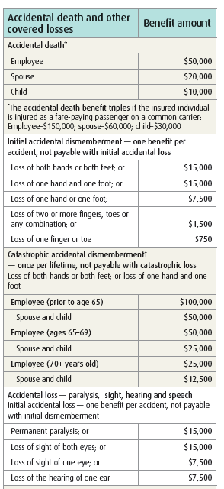
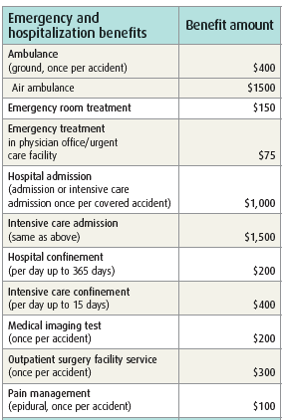
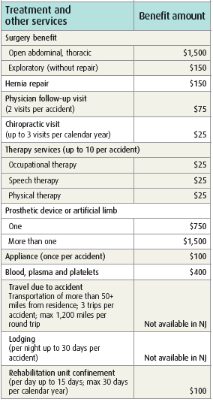
Group
Accident Insurance:
Continued…
Notes:
Today we’ll talk about….

Slide 8
Did you know?
The estimated annual incidence of heart attack in the US is over a million. And about every 40 seconds someone in America has a stroke.¹
Coverage Options:
Employee Coverage
$10,000 to $50,000 in $5,000 increments
Spouse Coverage
$5,000 to $30,000 in $1,000 increments
Child Coverage
$2,500 or $5,000 – Covers all children
Plan Features:
Since you own the coverage, you can take it with you if you leave your employer
Benefits reduce to 50% of coverage amount at age 70
30 day benefit waiting period
Covered Conditions:
Cancer
Carcinoma in situ (25%)
Heart Attack
Coronary Artery Bypass Surgery (25%)
Stroke
End Stage Renal (Kidney) Failure
Major Organ Transplant
Permanent Paralysis due to a covered accident
Benefit Highlights:
Can pay a set amount when a person is diagnosed with a covered serious condition, such as heart attack, stroke, organ failure, and more
Money is payable directly to employees to use however they choose
Rates lock in at policy issue
$50 Health Screening Benefit/annually
Critical Illness Insurance:
A lifeline when you’re seriously ill
If NY: The Individual Specified Disease policy provides limited benefits health insurance only. It does NOT provide basic hospital, basic medical or major medical insurance as defined by the New York State Department of Financial Services. The expected benefit ratio for this policy is 60%. This ratio is the portion of future premiums which the company expects to return as benefits, when averaged over all people with this policy.
In CT and NH, CI-01 is not available.
In CA, GA and MA, insured individuals must be covered by comprehensive health insurance before applying for benefits.
1 American Heart Association, “Heart Disease and Stroke Statistics – 2018 Update: A Report from the American Heart Association,” Circulation (Mar. 20,2018)
Please refer to the certificate for complete definitions of covered conditions
Notes:
Today we’ll talk about….

Slide 9

Enrollment Process:
1) Click here and register as a new user: Accept or Decline benefits (Login: Employee ID is the last 4 digits of your SS#)
2) Call or email ((866) 463 - 8808, option 4; support@premierworksite.com), to speak to a benefits representative (Monday - Friday, 9am-4pm EST) to answer questions, explain the benefits, provide rates, or enroll
3) A Representative will be at the NJ Warehouse and Corporate office on 7/18 as well as the Delaware Warehouse on 7/20
9
Notes:
Today we’ll talk about….

Slide 10
Disclosures
Group Accident Insurance, Individual Critical Illness Insurance (CI-01, CI-05) IS A/ARE LIMITED POLICY(IES).
Group Accident Insurance is/are underwritten by Unum Life Insurance Company of America, Portland, ME.
Individual Short-Term Disability insurance is underwritten by Provident Life and Accident Insurance Company, Chattanooga, TN.
The policy or its provisions may vary or be unavailable in some states. The policy has exclusions and limitations which may affect any benefits payable. See the actual policy or your Unum representative for specific provisions and details of availability.
Employees must be legally authorized to work in the U.S. and actively working at a U.S. location to receive coverage. Spouses and dependents must live in the U.S. to receive coverage.
Employees must be U.S. citizens, Canadian citizens working in the U.S., or have a green card to receive coverage. Spouses and dependents must live in the U.S. to receive coverage.
CE-137398
© 2019 Unum Group. All rights reserved. Unum is a registered trademark and marketing brand of Unum Group and its insuring subsidiaries.
10
Notes:
Today we’ll talk about….

